Slide 1
Change from baseline and Shift tables
Release Date: DD-Mmm-YYYY

Slide 2
Agenda
What is a Shift table
Layouts
Endpoints
Interpretation
Programming aspect
Challenges faced

Slide 3
What is a shift table?
A table to assess the categorical data
It displays number of subjects/patients who are low, normal, or high at baseline and the shift or transition at selected time points or time intervals
It displays number of subjects/patients who develop clinically significant values post baseline
Provides key information about the health and welfare of the subjects/patients during the clinical study

Slide 4
Layouts
Examples to be put here

Slide 5
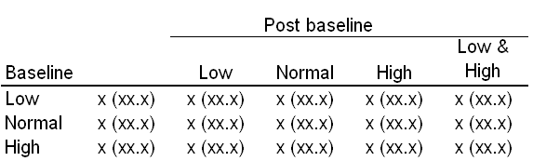
Endpoints: How to define “Endpoint”?
Endpoint - Worst value (Low, High, Low & High) - Last visit value in the study - Last non missing value on the treatment - Minimum value - Maximum value - Analysis by visit window - Averaged value within a visit window
Study - Different phases - Different objectives - Different inclusion/exclusion criteria - Different dosing schedules - Different visit schedules - Different labs - Population definition

Slide 6
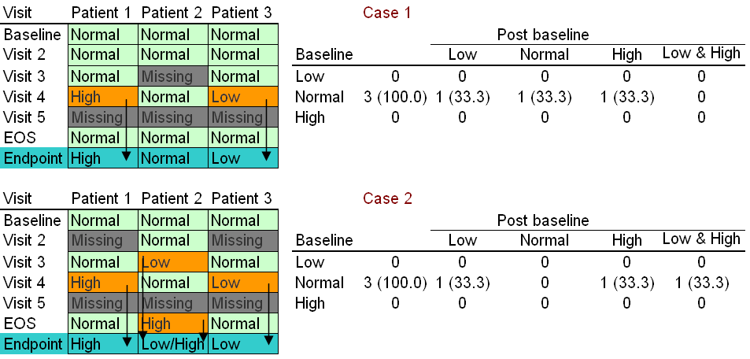
Endpoints: Worst value
- Post baseline: worst measurement on treatment - Well defined baseline and post baseline measurements

Slide 7
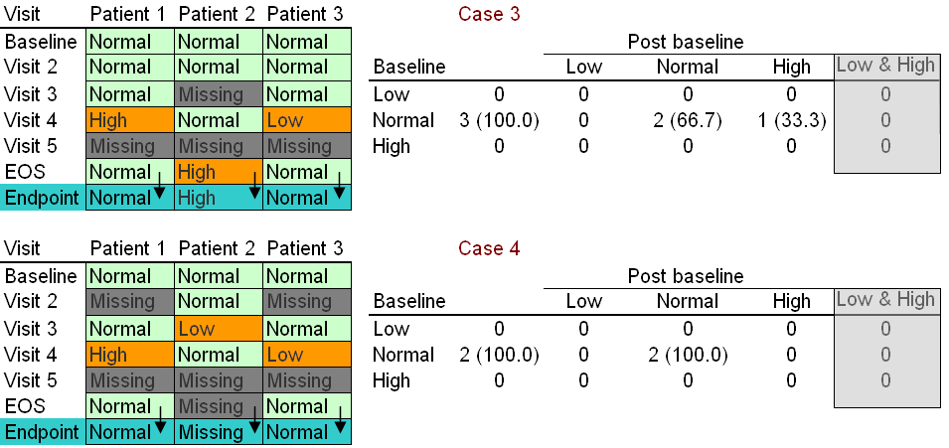
Endpoints: Last visit value in the study
- Low & High scenario not possible as single measurement contributes - Patient 2 with a “Normal” post baseline measurement does not contribute - If the EOS happens earlier than usual ?

Slide 8
Endpoints: Last non missing value on the treatment
- Low & High scenario not possible as single measurement contributes - Patient 2 with a “Normal” post baseline measurement does not contribute - If the EOS happens earlier than usual ?

Slide 9
Endpoints: Last non missing value on the treatment
- Low & High scenario not possible as single measurement contributes - Patient 2 with a “Normal” post baseline measurement does not contribute - If the EOS happens earlier than usual ?

Slide 10
Reference
wikepedia

Slide 11

Thank You!
For any feedback/comment/clarification please contact us at PALS@tcs.com
Copyright © 2012 Tata Consultancy Services Limited
V 00.00

Slide 12
DOCUMENT RELEASE NOTICE
This XXXX, Version aa.bb, is released for use in Tata Consultancy Services (TCS) with effect from DDMMYY
This Training Material is subject to TCS Document Control Procedure. TCS reserves the right to make additions, modifications or alterations to the existing content or release a newer version of this document.
Softcopy of the latest version of the document is available in the ABCDEFG
Comments suggestions or queries should be addressed to PALS@tcs.com.
Prepared by:
Text
Role
Date:
Text
Reviewed by:
Text
Role
Date:
Text
Approved by:
Text
Role
Date:
Text
Authorized by:
Text
Role
Date:
Text
Effective Date: DD-Mmm-YYYY

Slide 13
Change/Revision History
Revision Description | Slide No. | Rationale for the Change | Change type (Add/Modify/Delete) | Modified By | Date Modified (DD-Mmm-YYYY)
Initial Release | NA | NA | NA | NA | Na

